Slide 1
AtliQ Grands Hospitality Revenue Analysis
Organized By : Codebasics
Task : Provide Insights to Revenue Team
Created By : Ketan Korde
LinkedIn : https://www.linkedin.com/in/ketan-korde

Slide 2
Steps Involved
Loading Data Into PowerBI
Data Model Building
Cleaning Data
Creating Measures
Creating Dashboard
Generating Insights

Slide 3
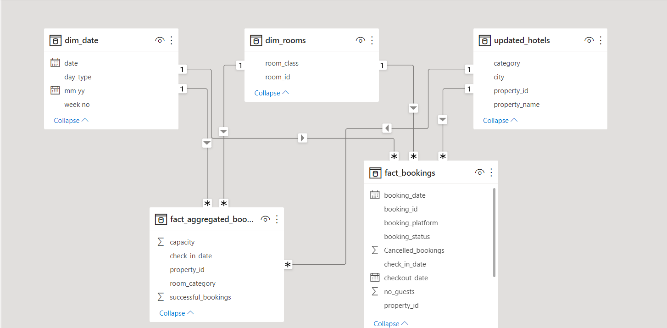
Data Model Building

Slide 4
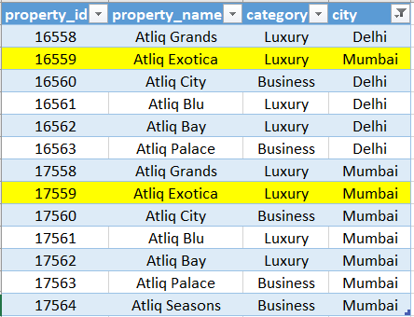
Data Cleaning
Each property_id has unique code. If we take first two digits it specifies city name.
For Example : 16 - Delhi
17 - Mumbai
18 – Hyderabad
19 – Bangalore
As shown in figure there were two Atliq Exotica based in Mumbai but in actuality one of them belonged to Delhi according to property_id.
So it needed to be corrected for further analysis.

Slide 5
Insights
Mumbai is generating major revenue and Hyderabad is generating low revenue.
Instead of generating low revenue Delhi & Hyderabad have more ratings and occupancy rate.
Majority of bookings coming from source called others. Needs to identify what source it is.
Occupancy rate is higher in Weekends and Presidential Class compare to Weekdays.
Highest revenue was generated in month of May and then it dropped in June but somewhat recovered in July so needs to identify what was done differently in July compare to June to generate more revenue.
Luxury category have more bookings than Business category.

